Slide 1

Notes:
Good afternoon everyone. We are team 4g. Our topic for COVID-19 challenge is how to ensure people’s mental health in 2020 COVID-19 pandemic. We got our insights by using NLP to analyze tweets on twitter.

Slide 2
01
BACKGROUND
02
OBJECTIVE
03
DATA EXPLORATION
content
04
SENTIMENT ANALYSIS
05
WORDCLOUD
06
TOPIC MODELING
07
SUGGESTIONS
Notes:
These are what we will cover in today’s presentation, from background to modeling part and in the end, our suggestions based on the results.

Slide 3
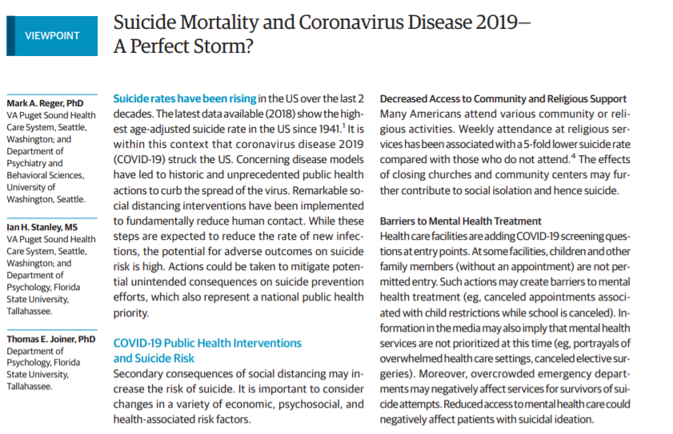

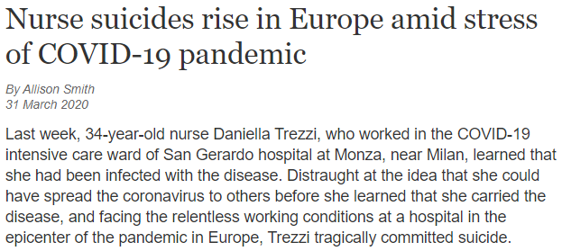
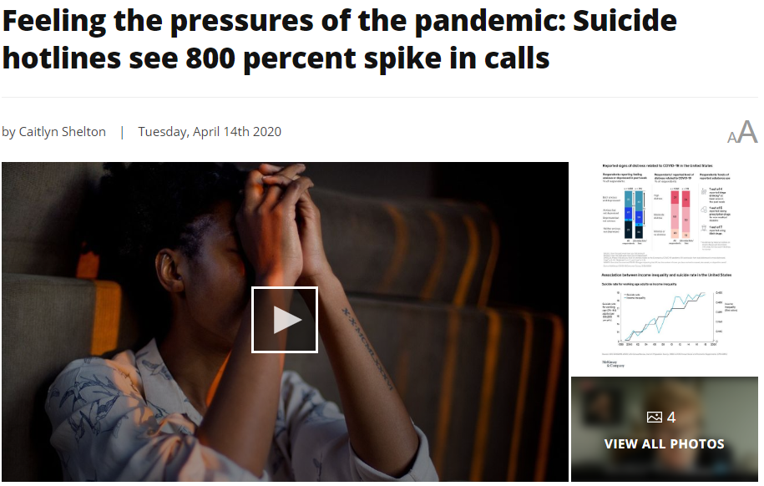
BACKGROUND
Source:
1. Reger MA, Stanley IH, Joiner TE. Suicide Mortality and Coronavirus Disease 2019—A Perfect Storm? JAMA Psychiatry. Published online April 10, 2020. doi:10.1001/jamapsychiatry.2020.1060
2. https://www.wsws.org/en/articles/2020/03/31/trez-m31.html
3. https://fox17.com/news/local/feeling-the-pressures-of-the-pandemic-suicide-hotlines-see-800-percent-spike-in-calls
Notes:
So why we want to focus on this topic?
We all know that coronavirus is spreading widely in the world, so in general, we would pay more attention to people’s physical health.
However, according to academic studies and news, people are faced with serious mental problems as well.
As the examples shown here, suicide mortality is increasing in the US, nurse suicides rise in Europe, and suicide hotlines see a surprising increase in calls.
It’s obvious that mental health needs to be paid more attention now. So our group focus on this topic, and this is realized by analyzing tweets on twitter.

Slide 4

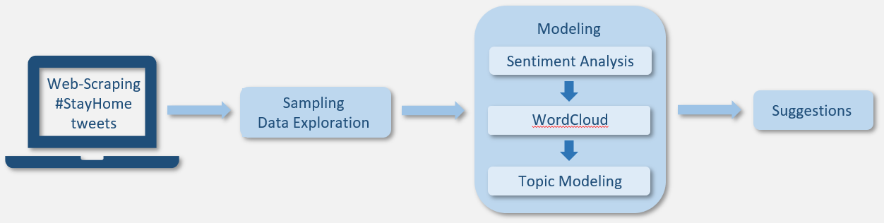
OBJECTIVE
Our objective is to ensure people’s mental health in the special COVID-19 pandemic.
We will give detailed suggestions to people who feel mental discomfort during the quarantine period.
Logic of our project
Notes:
So our objective is to ensure people’s mental health in the special COVID-19 pandemic.
And we will give detailed suggestions to people who feel mental discomfort during the quarantine period.
This is the logic of our project.
Our data source is Tweets with the hashtag #StayHome on Twitter,
and our main analysis method is to understand the emotions of people and identify possible factors that influence their emotions, like a specific topic or activity.
The main tool we use is NLP, including sentiment analysis, word clouds, and topic modeling.

Slide 5
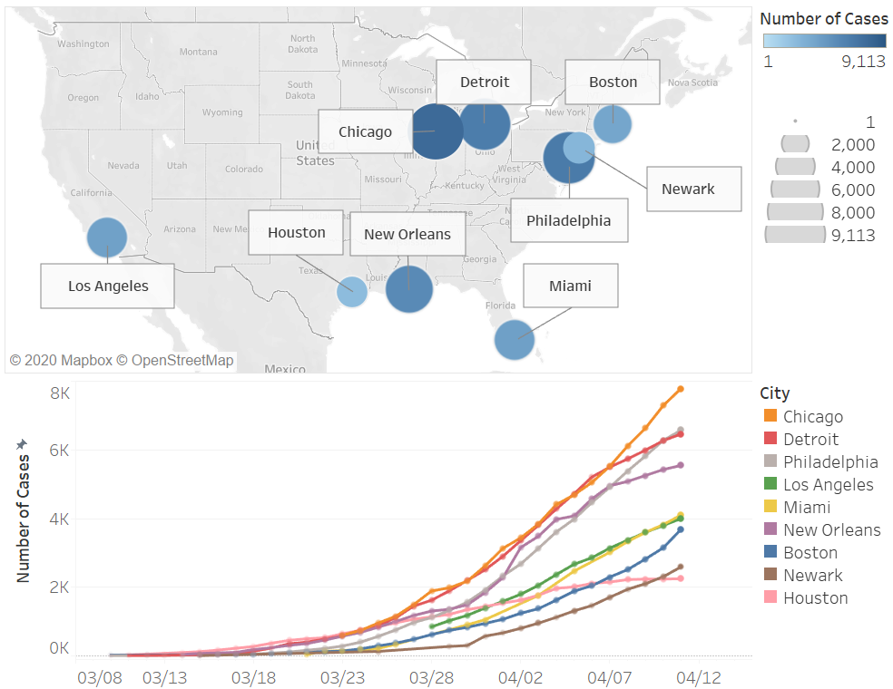
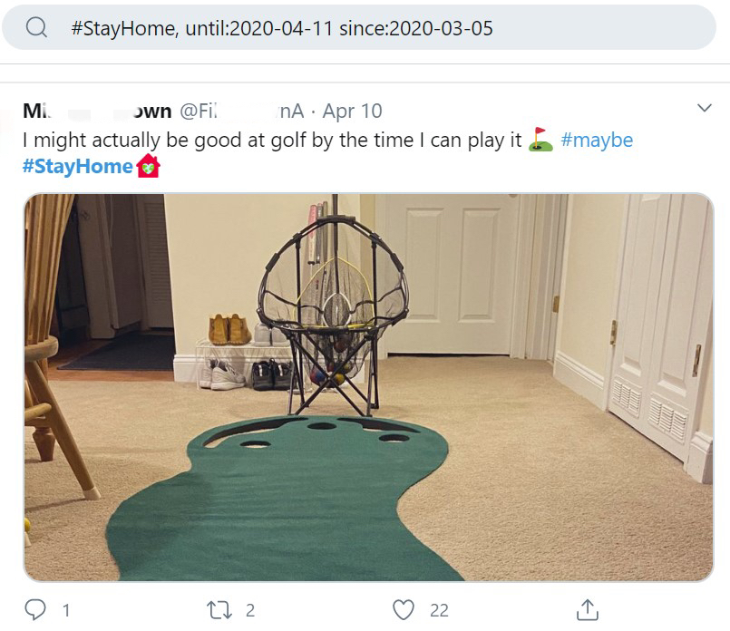
DATA EXPLORATION
Data Selection
New York
12,000 tweets under #StayHome
Number of confirmed cases in selected 10 cities
Data Source: Page 14, reference 5-12
Notes:
We selected 10 big cities with more than 2,000 cases as our target, because people in these places are more likely to suffer from depression due to the severe situation. Meanwhile, they have enough Twitter users to meet our data needs.
As we can see, New York has far more cases than the other, so after removing it from the charts, we can see the trend of other cities more clearly.
Then we used python to scrape tweets of users who live in these cities. In particular, we look at the hashtag ‘#StayHome’, which is one of the most effective methods to stop virus from spreading. We got around 12,000 tweets between March 5th and April 11th.
# The 10 cities are New York City, Boston, Chicago, Detroit, Los Angeles, Houston, Newark, Miami, Philadelphia and New Orleans.

Slide 6
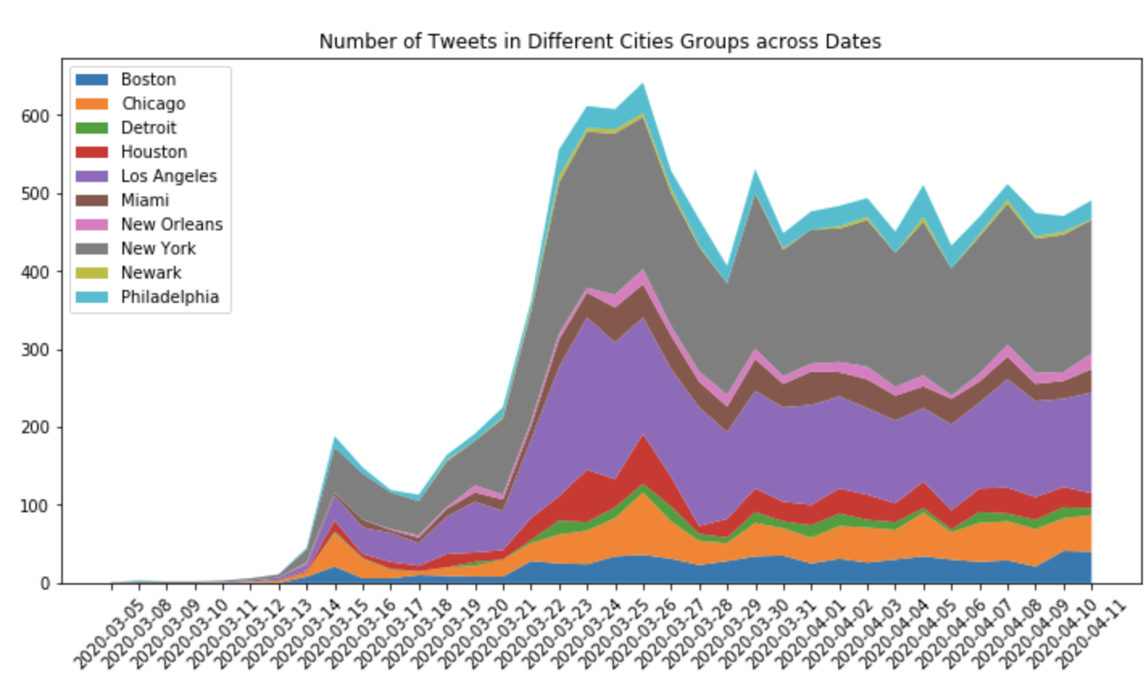
DATA EXPLORATION
The start date of shelter in place order in NY.
There is a sudden increase in tweet number around late March. This is when most states started the shelter in place order.
Notes:
This area plot shows the number of tweets in the 10 cities. It’s easy to notice that, for most of them, there is a sudden increase in tweet number around late March. This is when most states started the shelter in place order. so people started to ‘Stay at Home’ and talked more about it on Twitter.
This reinforces our assumption that social media posts like tweets can reflect people’s activities and possibly emotions during this pandemic.
#For example, New York announced this order on March the 22nd, which is indicated by the vertical line. And we can find an obvious increase around this date. It possibly increased people’s awareness of COVID-19,

Slide 7
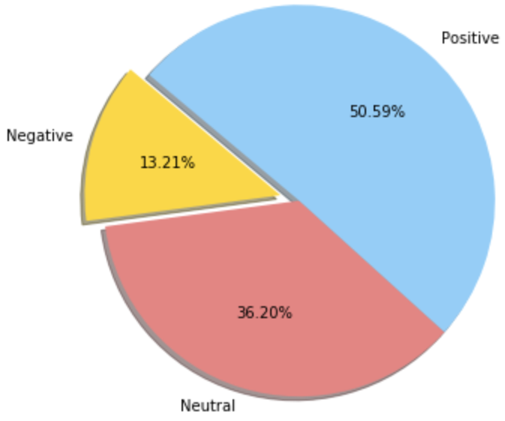
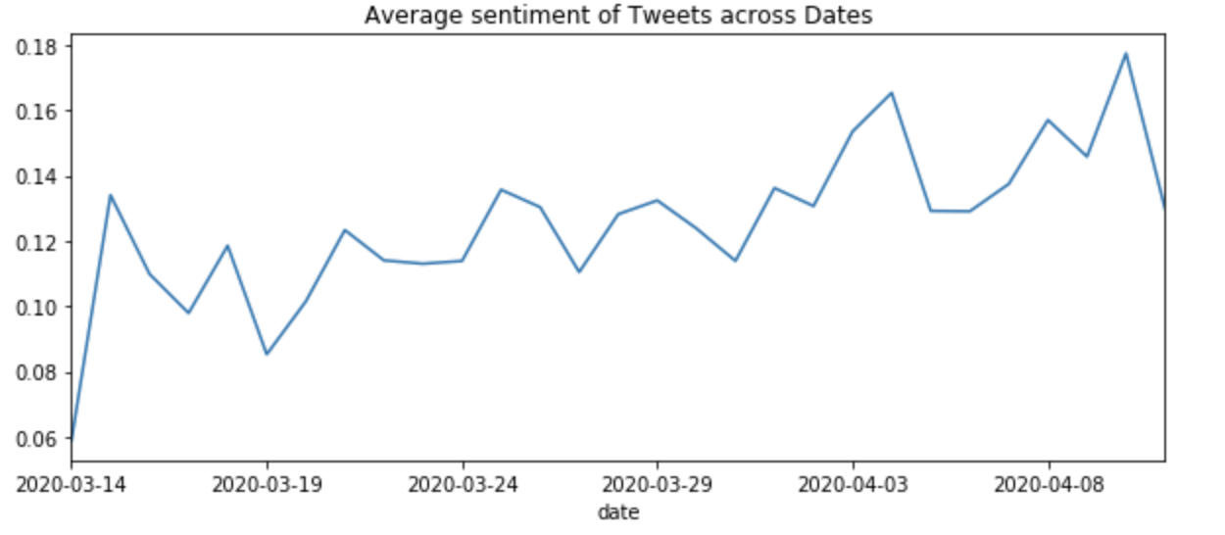
SENTIMENT ANALYSIS
Tweets
Text Preprocessing
Proportion of different sentiment groups
TextBlob
Polarity Score [-1,1]
<0
=0
>0
Negative
Neutral
Positive
Average sentiment of tweets across Dates
Notes:
We started from conducting sentiment analysis on our data. We analyzed the tweets and tried to understand people’s opinion expressed by the text. Using the textblob library in Python, we can quantify the sentiment behind each tweet with a positive or negative value, called polarity. A positive polarity score indicates overall positive sentiment, a negative score indicates negative sentiment, and 0 means neutral sentiment.
According to the pie chart, around half of the tweets are positive, and only 13% of them shows negative emotions.
We also plotted the average sentiment score over time, and we can see that generally people’s tweets are becoming more and more positive.

Slide 8
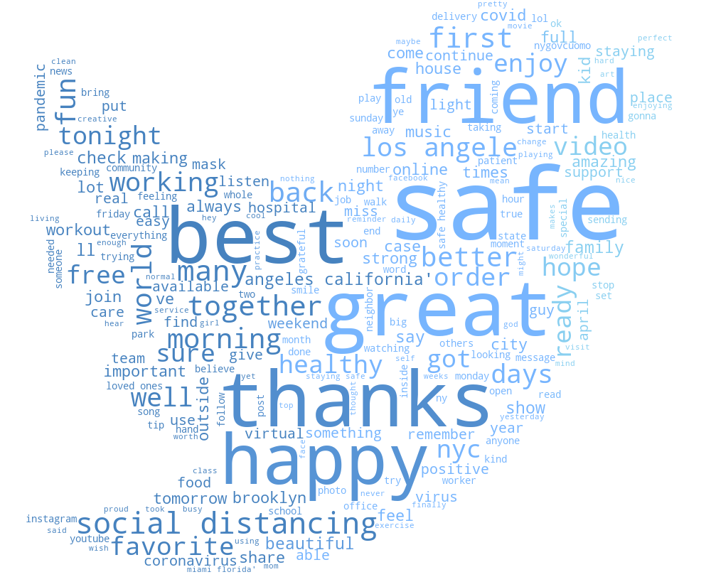
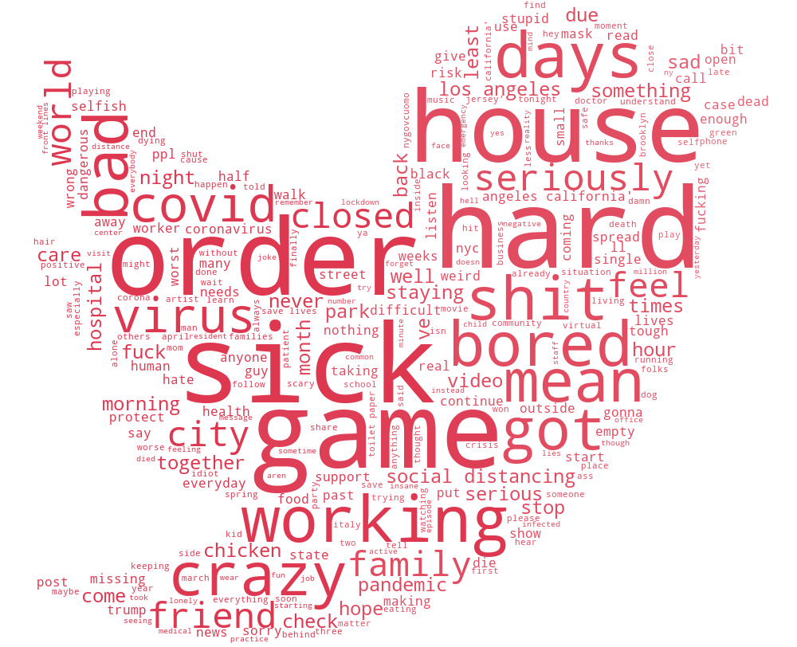
WORDCLOUD
Positive
Negative
Notes:
After dividing the tweets into positive, negative, and neutral categories based on polarity, we calculated the word frequencies for positive tweets and negative tweets separately and drew a word cloud for each of the two categories.
From the first word cloud, we can see that positive tweets often contain positive words like “safe”, “great”, “happy”. There are also words like “video”, “music” that imply positive activities.
From the second word cloud, we can infer that negative tweets are mainly expressing worries about being sick, or complaining about being bored after staying at home for a long time.

Slide 9


TOPIC MODELING
Millions of Tweets
30 Topics
13 Topics
friend/family/grateful/neighbor
read/weekend/exercise/book
love/prayer/hand/wash
watch/video/share/youtube
free/food/donate
good/feel/world/moment/photo
word/message/picture
play/happy/music/game
challenge/workout/fresh/air
food/eat/house/clean
amazing/dinner/cook
show/favorite/movie
order/call/online/delivery
beautiful/smile/pretty/staff
Topic Modeling
time/remember/week/ago
Select Topics Related to Activities
friend/neighbor/family/grateful
LDA Mallet
mask/face/wear
…...
Notes:
Topic Modeling
We first tried out different number of topics to do topic modeling and used coherence value to choose the perfect number of topics. We decided that 30 topics are suitable for all the tweets data we have. Then we use keywords, which was the common words in each topic, to select related activities. There are 13 related activities derived from these 30 topics.

Slide 10
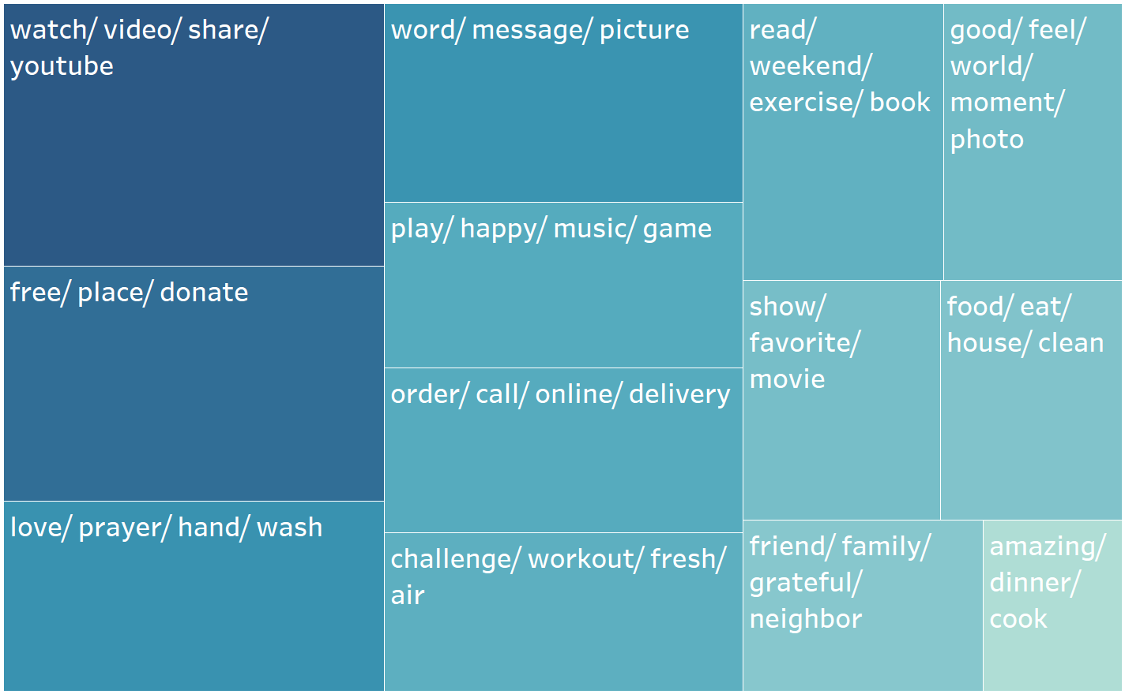
TOPIC MODELING The TreeMap of 13 activity-related topics
The larger and the darker the area, the more positive the topic
Notes:
After choosing the 13 topics, we calculated the average polarity of each topic, and here is the TreeMap. The area and color are determined by the polarity of each topic, which means the larger the area and the darker the color, the more positive the topics are.
Therefore, activities at the top-left are the most positive ones. Like: watch videos, donate, communication though word and message.
On the other hand, activities at the bottom right are the least positive ones, like cook dinner.

Slide 11
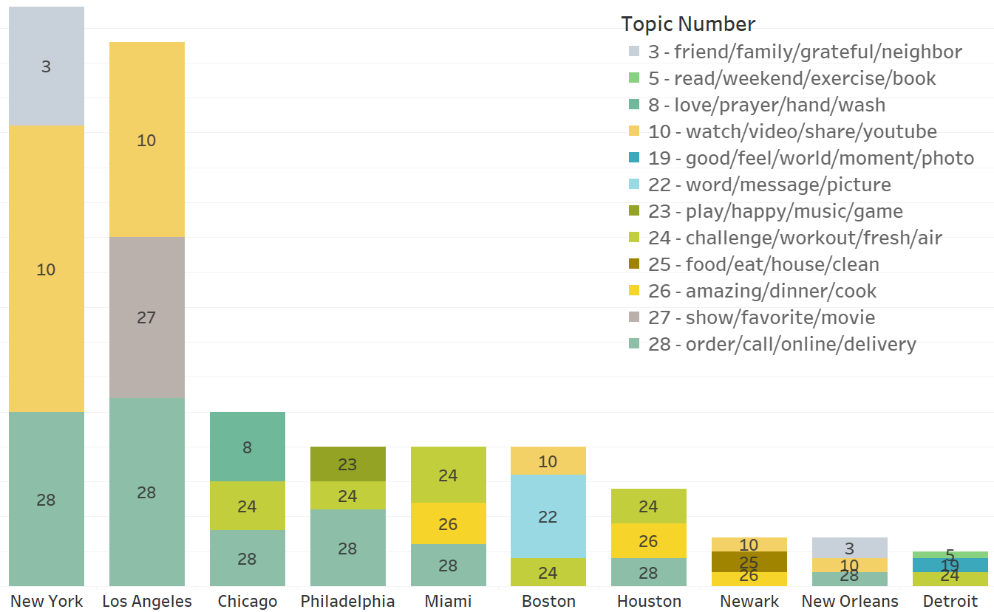
TOPIC MODELING The top3 activities across different cities
Notes:
Besides the sentiment of topics, we are also curious about what activities people do across different cities. So we listed the top3 activities in each city based on the number of tweets related to the topic. We got several interesting findings:
Watch videos, workout and delivery are the popular activities in many cities.
People in New York prefer staying with their friends and family, people in LA most like watching shows and movies
Communication through word, message and picture is very popular in Boston.
People in different cities do have prefered activities!

Slide 12
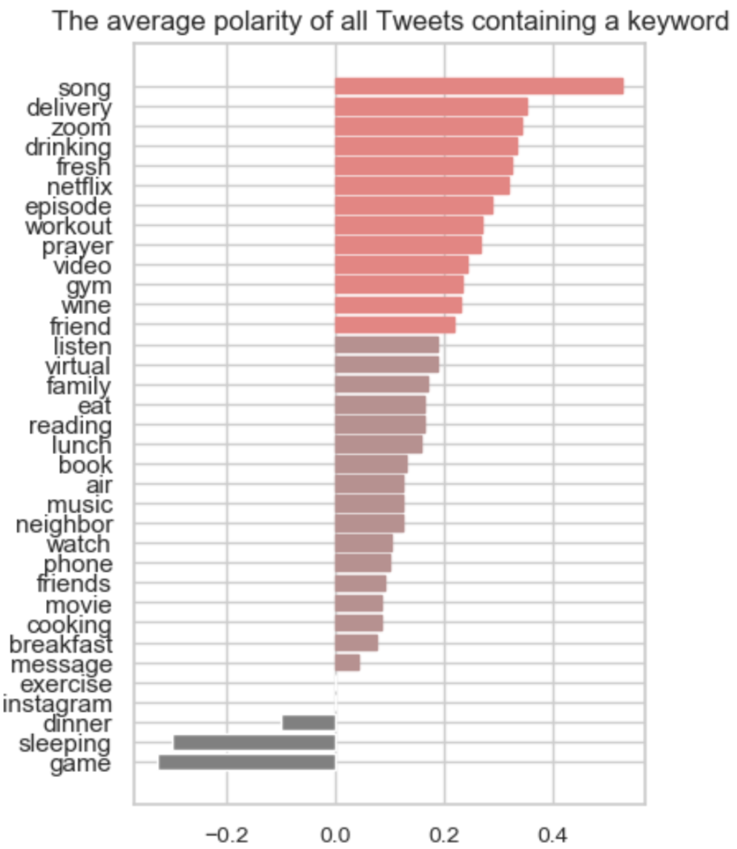
Words that have strong positive sentiments
delivery
song
netflix
drinking
video
wine
episode
zoom
friend
gym
prayer
Notes:
Besides topics, we want to know more about the specific words influence people’s feeling. So we picked a list of high-frequency words from these topics and calculated the average polarity of all Tweets containing each word. The bar chart on the left ranks the words according to its polarity. The words colored light red are the most positive ones and we put them to the right.
Consistent to the topic modeling result, videos, virtual connection and gym have very positive sentiments. Besides, Activities like song, delivery, drinking wine and prayer are also super positive.
It is worth to note that the word “game” ranks the last in the bar chart, which disagrees with our knowledge that playing games helps people feel better.

Slide 13
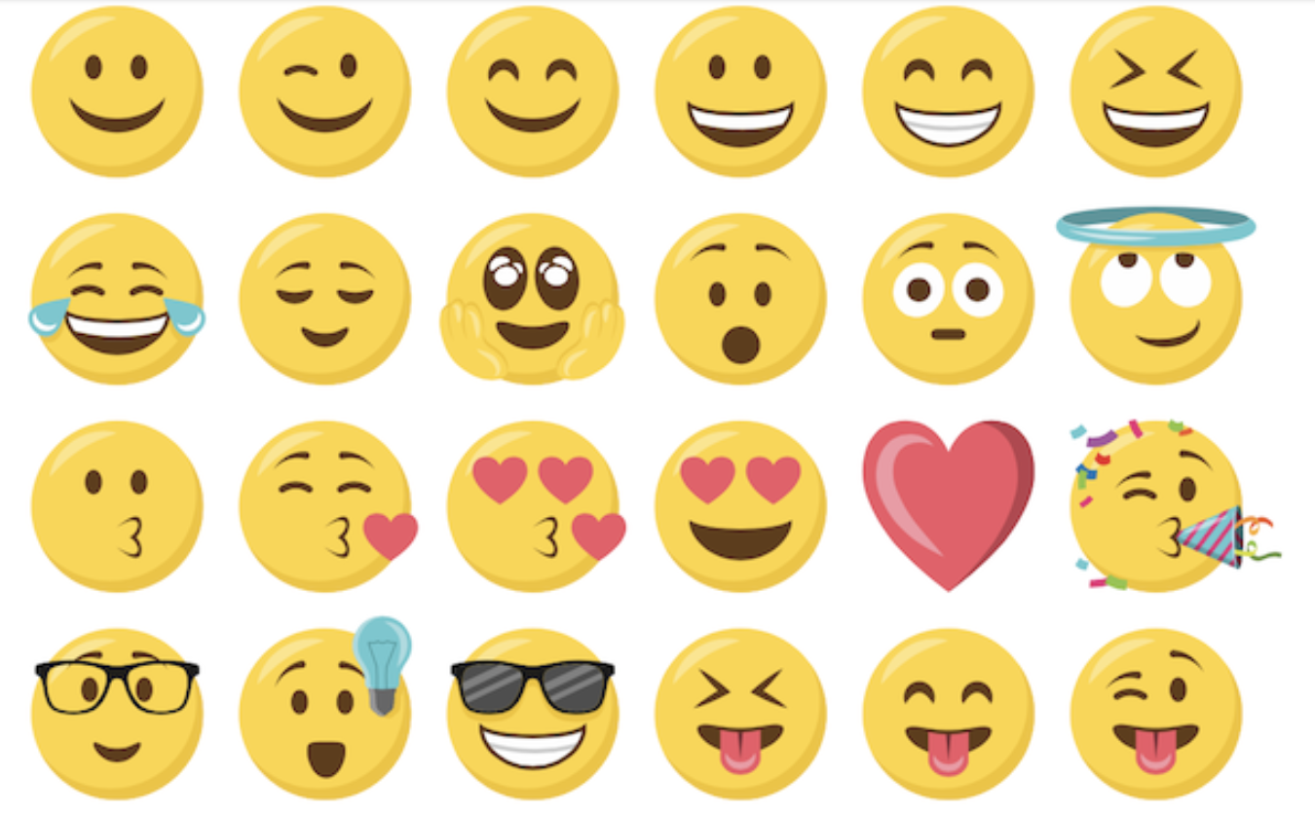
SUGGESTIONS
Music: Listen to songs or sing songs
Videos: Watch movies or TV series on YouTube and Netflix
Connection: Virtually connect with others through messages, phone, or video talks
Workout: Do a regular workout and breath fresh air
Kindness: Share free food or donate money
Prayer: Say a prayer
Delivery: Enjoy more delicious food by online ordering
Games: Stop playing games all day!
Notes:
Based on the analysis on topics and single word, we give the following suggestions to people who feel mentally discomfort.
There are several popular that are proved to be very positive: including listening to and singing songs, watch movies or TV series, virtually connecting with your closed ones even though you are physically distant, and workout.
Besides, we also found several activities that are surprisingly very helpful to your emotions:
First, help others, whether sharing free food or donating money helps you feel better
Second, say a prayer does help release your emotional discomfort
Third, ordering food online rather than cooking has a more positive effect on your emotion, where you can enjoy more delicious food
Last but not the least, Stop playing games all day. It’s not a very good way to make you happy.

Slide 14
REFERENCES
Reger MA, Stanley IH, Joiner TE. Suicide Mortality and Coronavirus Disease 2019—A Perfect Storm? JAMA Psychiatry. Published online April 10, 2020. doi:10.1001/jamapsychiatry.2020.1060
https://www.wsws.org/en/articles/2020/03/31/trez-m31.html
https://fox17.com/news/local/feeling-the-pressures-of-the-pandemic-suicide-hotlines-see-800-percent-spike-in-calls
https://github.com/Mottl/GetOldTweets3
https://www.chicago.gov/city/en/sites/covid-19/home/latest-data.html
https://detroitmi.gov/departments/detroit-health-department/programs-and-services/communicable-disease/coronavirus-covid-19#vizContainer
https://publichealth.harriscountytx.gov/Resources/2019-Novel-Coronavirus
http://publichealth.lacounty.gov/media/Coronavirus/
https://www.floridadisaster.org/covid19/covid-19-data-reports/
http://ldh.la.gov/Coronavirus/
https://essexcountynj.org/covid-19-municipality/
https://www.phila.gov/programs/coronavirus-disease-2019-covid-19/testing-and-data/#covid-19-positive-test-results

Slide 15
Thank you!

